Slide 1
Calories-Burned-Prediction Domain: Machine Learning

Slide 2
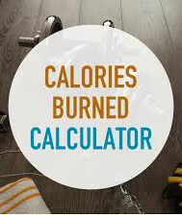
Introduction:
In today's fast-paced world, individuals increasingly rely on wearable fitness trackers and mobile applications to monitor their physical activity and track the number of calories burned. While these tools provide valuable insights, there is a growing need for more personalized and accurate methods of predicting calories burned. This can be achieved through the application of machine learning techniques. Our task is to build a machine learning model that can accurately predict the number of calories burned during various physical activities.

Slide 3
Technologies Used: Python: The primary programming language used for data processing, model building, and evaluation. Machine Learning Algorithms: Linear Regression: A simple yet effective algorithm for establishing a linear relationship between features and the target variable. Decision Tree Regression: A non-linear algorithm that splits data into subsets based on feature values, providing a tree-like model of decisions. Random Forest Regression: An ensemble learning method that builds multiple decision trees and merges them to improve accuracy and prevent overfitting. XGBoost Regressor: An optimized gradient boosting algorithm designed to be highly efficient and accurate, often outperforming other models.
.

Slide 4
Procedure:
Data Collection: Gather data from wearable fitness trackers or other sources that include features such as age, weight, height, duration of activity, type of activity, and heart rate.
Data Preprocessing: Split the data into training and testing sets to evaluate model performance.
Model Building: Implement and train multiple machine learning models (Linear Regression, Decision Tree Regression, Random Forest Regression, and XGBoost Regressor) using the training dataset.
Model Evaluation: Evaluate the models using metrics such as Mean Absolute Error (MAE), Mean Squared Error (MSE), and R-squared (R²) on the testing dataset.Compare the performance of different models to select the best one.
Model Deployment: Deploy the model into a real-world application where it can be used to predict calories burned based on user input in real-time.

Slide 5
After training and evaluating the models, the following results were obtained: Based on the evaluation metrics, the XGBoost Regressor provided the most accurate predictions with the lowest error rates and the highest R-squared value. This indicates that XGBoost is the best model for predicting calories burned during physical activities.
Results:
Linear Regression: MAE: 35.2 MSE: 1456.3 R²: 0.72 | Decision Tree Regression: MAE: 25.1 MSE: 976.4 R²: 0.82
Random Forest Regression: MAE: 20.5 MSE: 785.3 R²: 0.88 | XGBoost Regressor: MAE: 18.3 MSE: 675.1 R²: 0.91

Slide 6

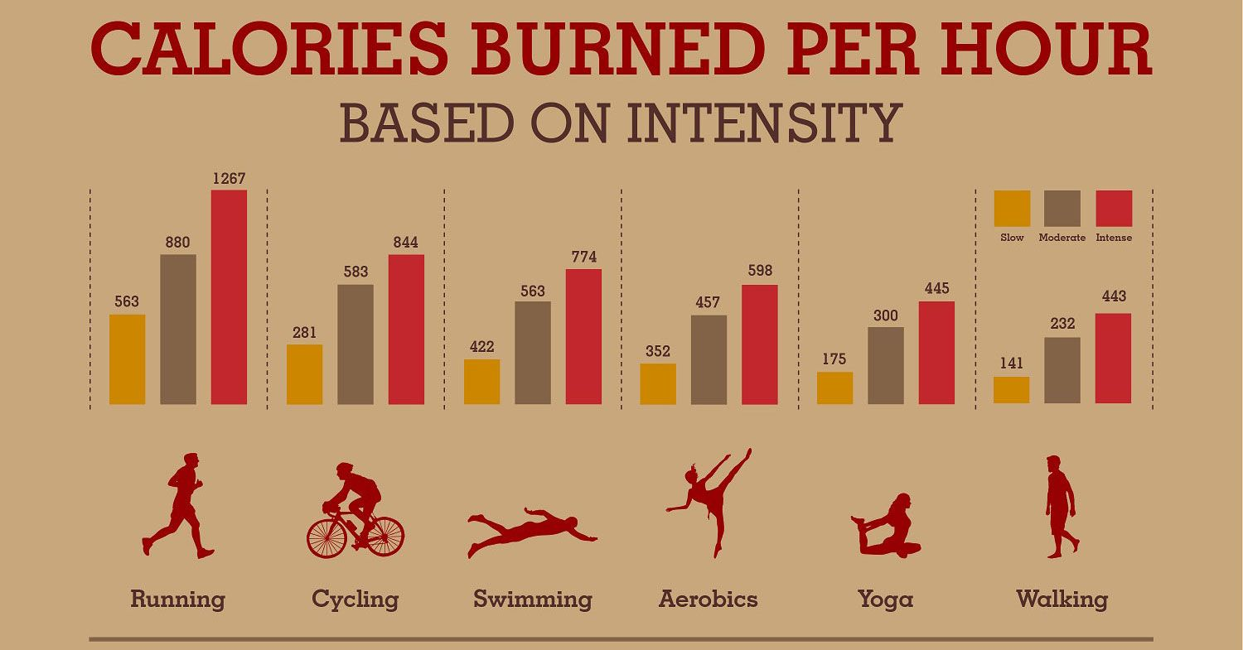
physical activities with high accuracy

Slide 7
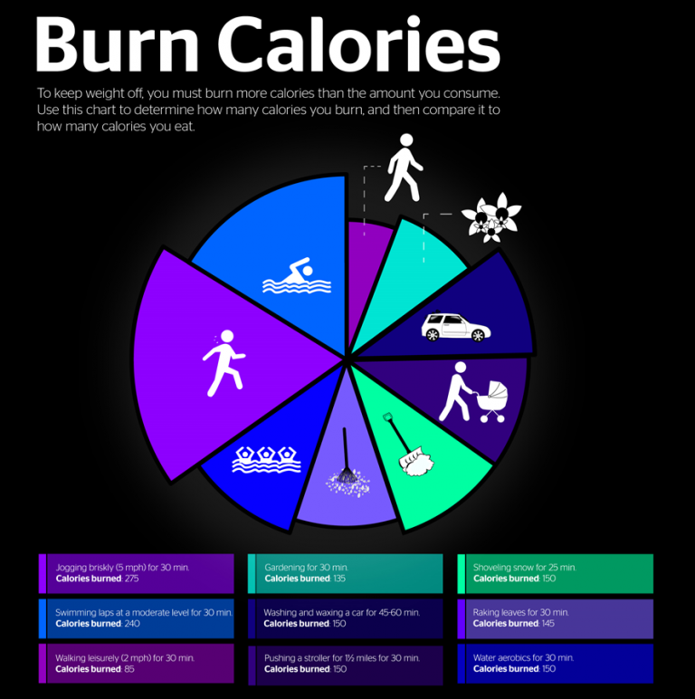
Conclusion: By leveraging machine learning algorithms, we developed a highly accurate model to predict calories burned during physical activities. Advanced algorithms like XGBoost enhance prediction precision, providing users with a personalized and reliable monitoring method. This model can be integrated into wearable fitness trackers and mobile apps, promoting healthier lifestyles.

Slide 8
Thank you
Garlapati Sai Vinny Reddy- 245521733147
G Karthik: 245521733144
Vaddemoni Hari Priya: 245521733191

